Slide 1
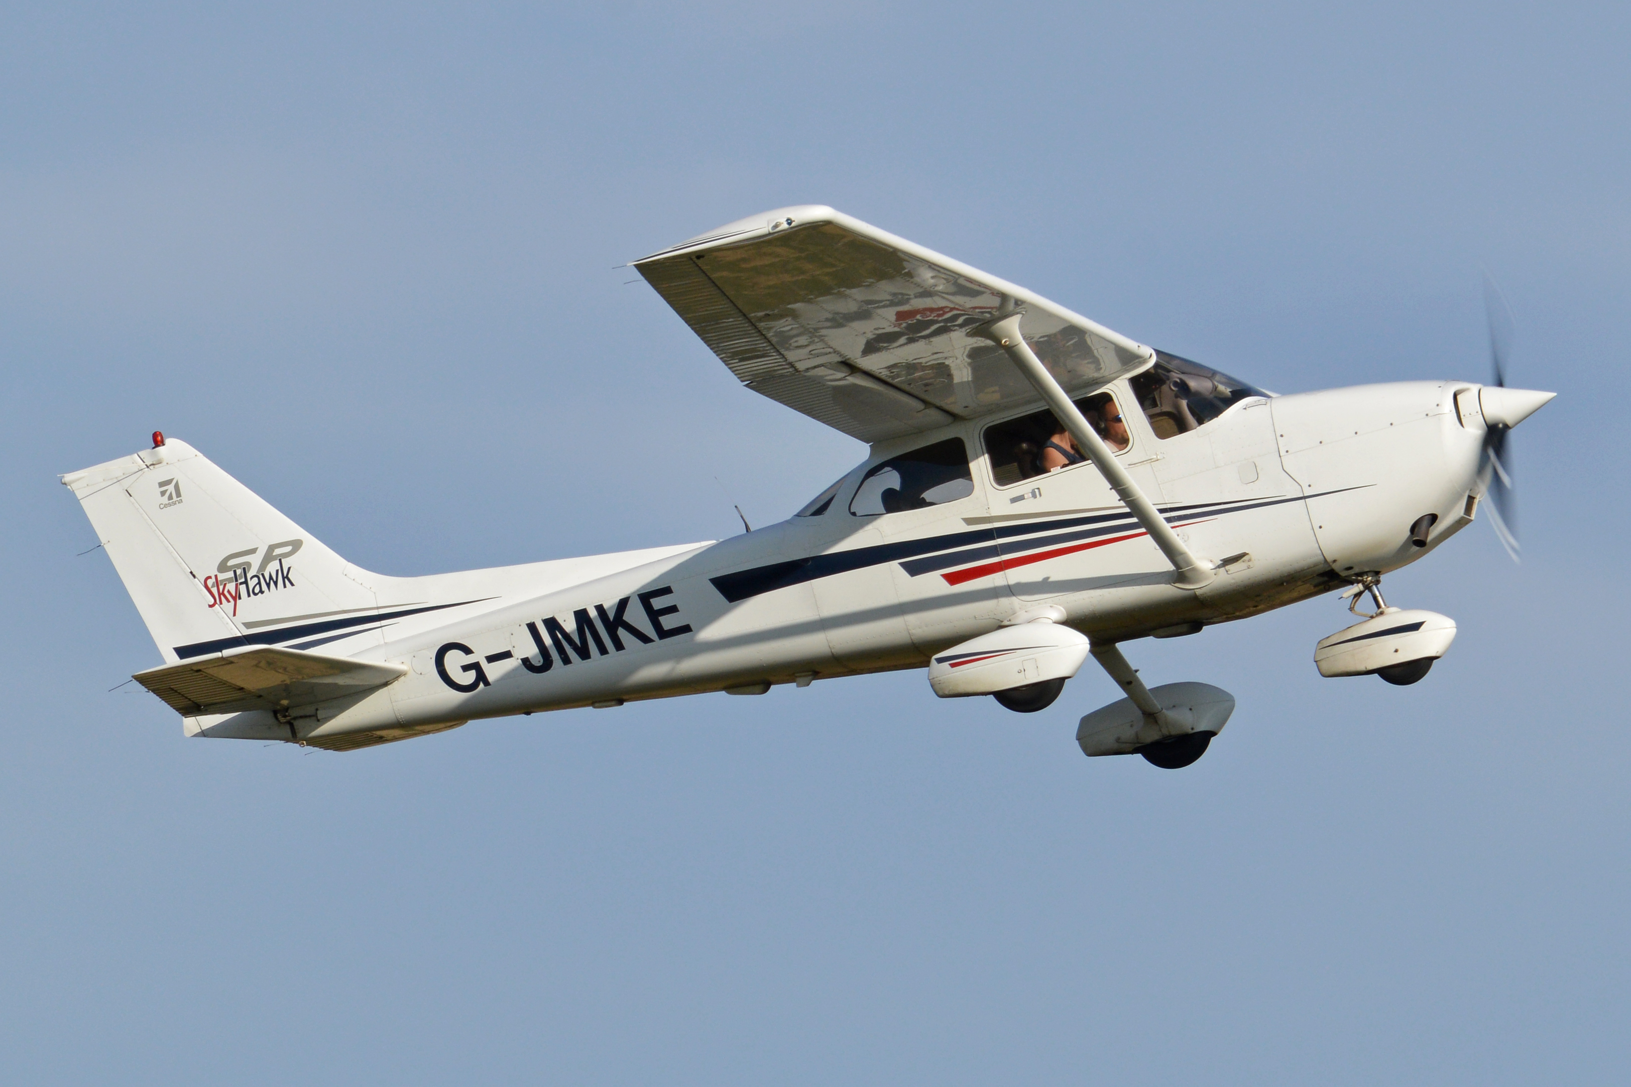
Aircraft Accidents Analysis to Determine The Most Viable Aircrafts for Purchase

Slide 2
Objective
The purpose of this analysis is to look at previous aircraft accidents, so as to come up with an informed decision of the type of aircraft to purchase.

Slide 3
Key Questions:
Which aircraft make/models have more accidents, and which have less?
What is the type of damage that occurs when the accidents happen?
Does the type of damage affect number of injuries?

Slide 4
Cont…
What's the most common accident by purpose of flight?
Which phase of flight is more prone to accidents?
Which weather condition is affected most?

Slide 5
Data Understanding
The data was derived from Kaggle which is a database of the NTSB(national transport and safety board) that has information about selected incidents within the United States and in International waters.

Slide 6
The data set has the following information:
Event Details : ID, Accident Number, Event Date, Location, Country, - - Airport information
Aircraft details: Registration number, Make, Model, Number of engines, Engine type, Schedule, Purpose of flight Type of damage.
Injuries: Fatal injuries, Serious injuries, Minor injuries, Uninjured

Slide 7
Cont.…
Weather condition
Report status
Publication date

Slide 8
Visualizations

Slide 9
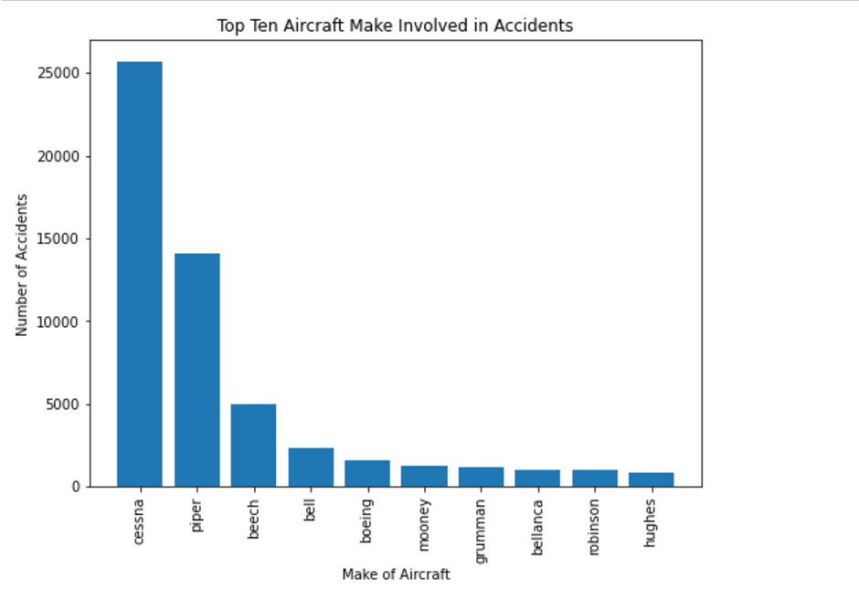
1. Aircraft Make
We'll first look at the top ten aircrafts involved in the accidents, since our data is large.

Slide 10
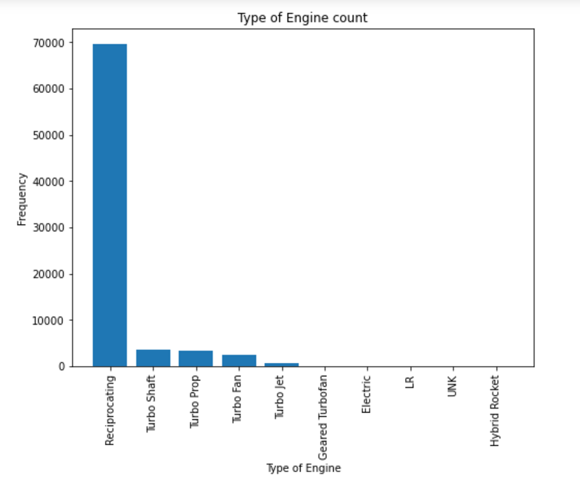
2. Engine Type
Aircrafts have different types of engines. Let's take a look at the types in our data

Slide 11
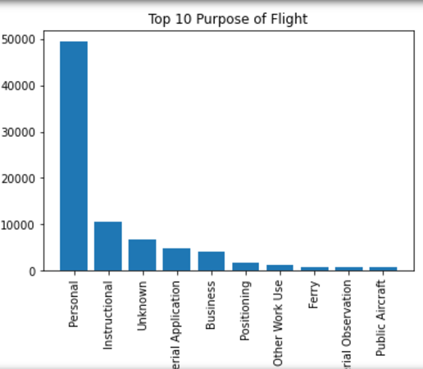
3. Purpose of flight
There are different purposes when the planes take to the skies. Let's take a look at this.

Slide 12
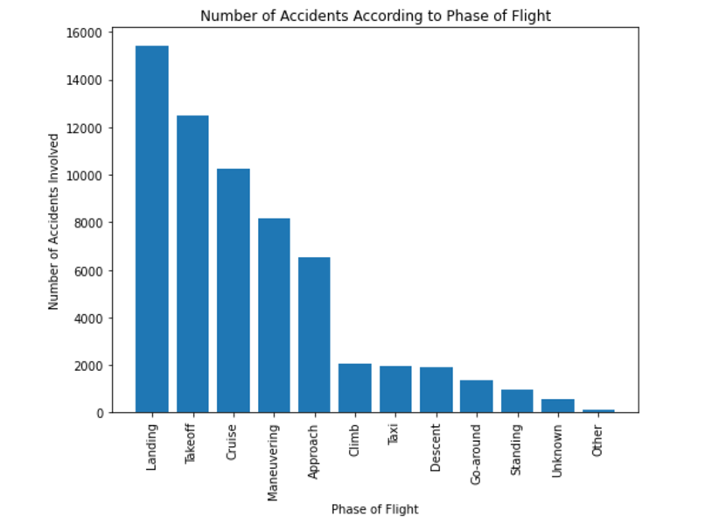
4. Phase of Flight
Which phase of flight were these planes when the accident occurred? Let's take a look.

Slide 13
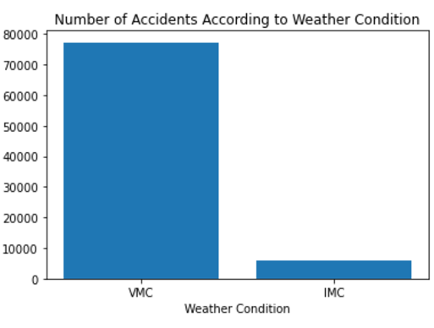
5. Weather Condition
VMC - Visual meteorological Condition
IMC - Instrument meteorological Condition.

Slide 14
CONCLUSION

Slide 15
Most planes involved in accidents are for personal use, and not commercial use
Also, the most kind of aircrafts, according to the type of engine are small planes, which explains why it was for personal use.
According to the graphs seen, we would presume that the top ten aircrafts are not safe to start the business with.

Slide 16
There is insufficient data to make this conclusion, since we have not considered other factors like price of the planes, and/ maintenance cost.
It could be that Cessna, Piper, and Beech are cheaper or easy to maintain, hence their popularity.
More research needs to be done to come with substantial decision on the kind of aircraft to purchase to start off the business.

Slide 17
THANK YOU!!!

Slide 18
QUESTIONS
NAME: LIONEL AJELITI
Linkedin Profile :LIONEL AJELITI
EMAIL: lionelajeliti@gmail.com

